Slide 1


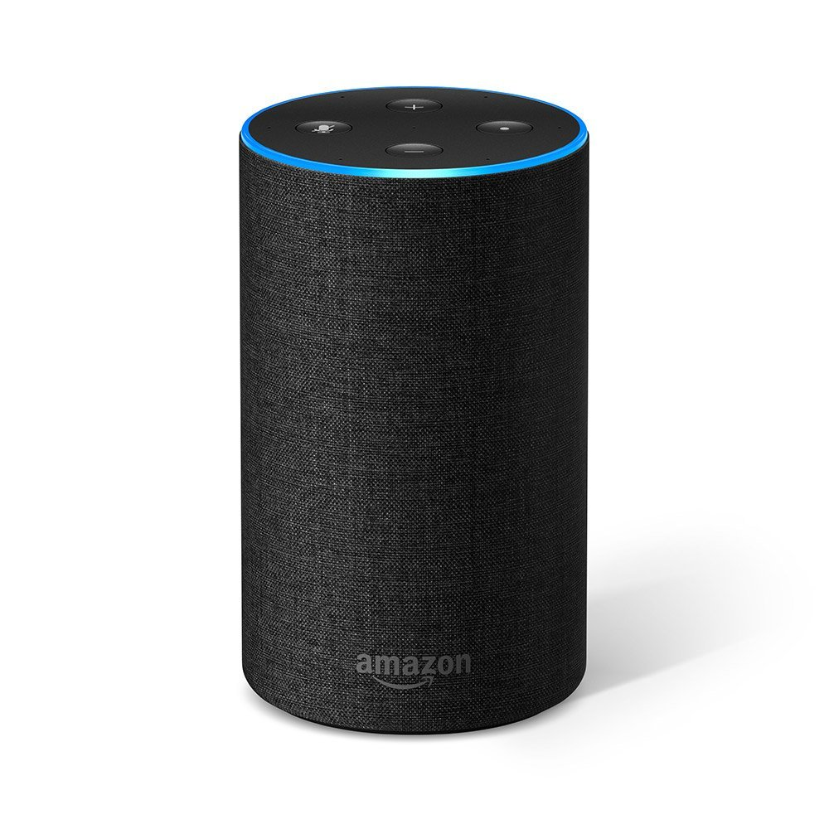
Smart Door Viewer
“ Ask Alexa to know who is at your door “

Slide 2
What is Smart Door Viewer ?
This is an Alexa skill which helps you in recognizing who is at your door.
This skill uses Raspberry PI and AWS cloud components like
AWS S3: A storage service.
AWS Lambda: A compute service for on demand computation.
AWS SQS: A message queuing service.
AWS Rekognition: A service which provides a way to train face recognition model on custom photos.

Slide 3
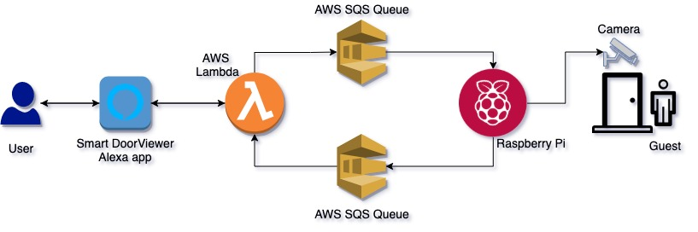
Project Architecture

Slide 4
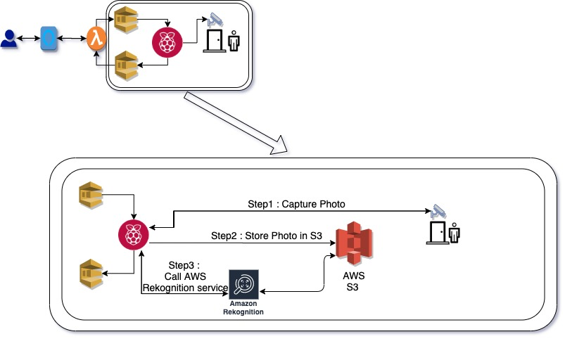
Detailed Architecture

Slide 5

DEMO

Slide 6
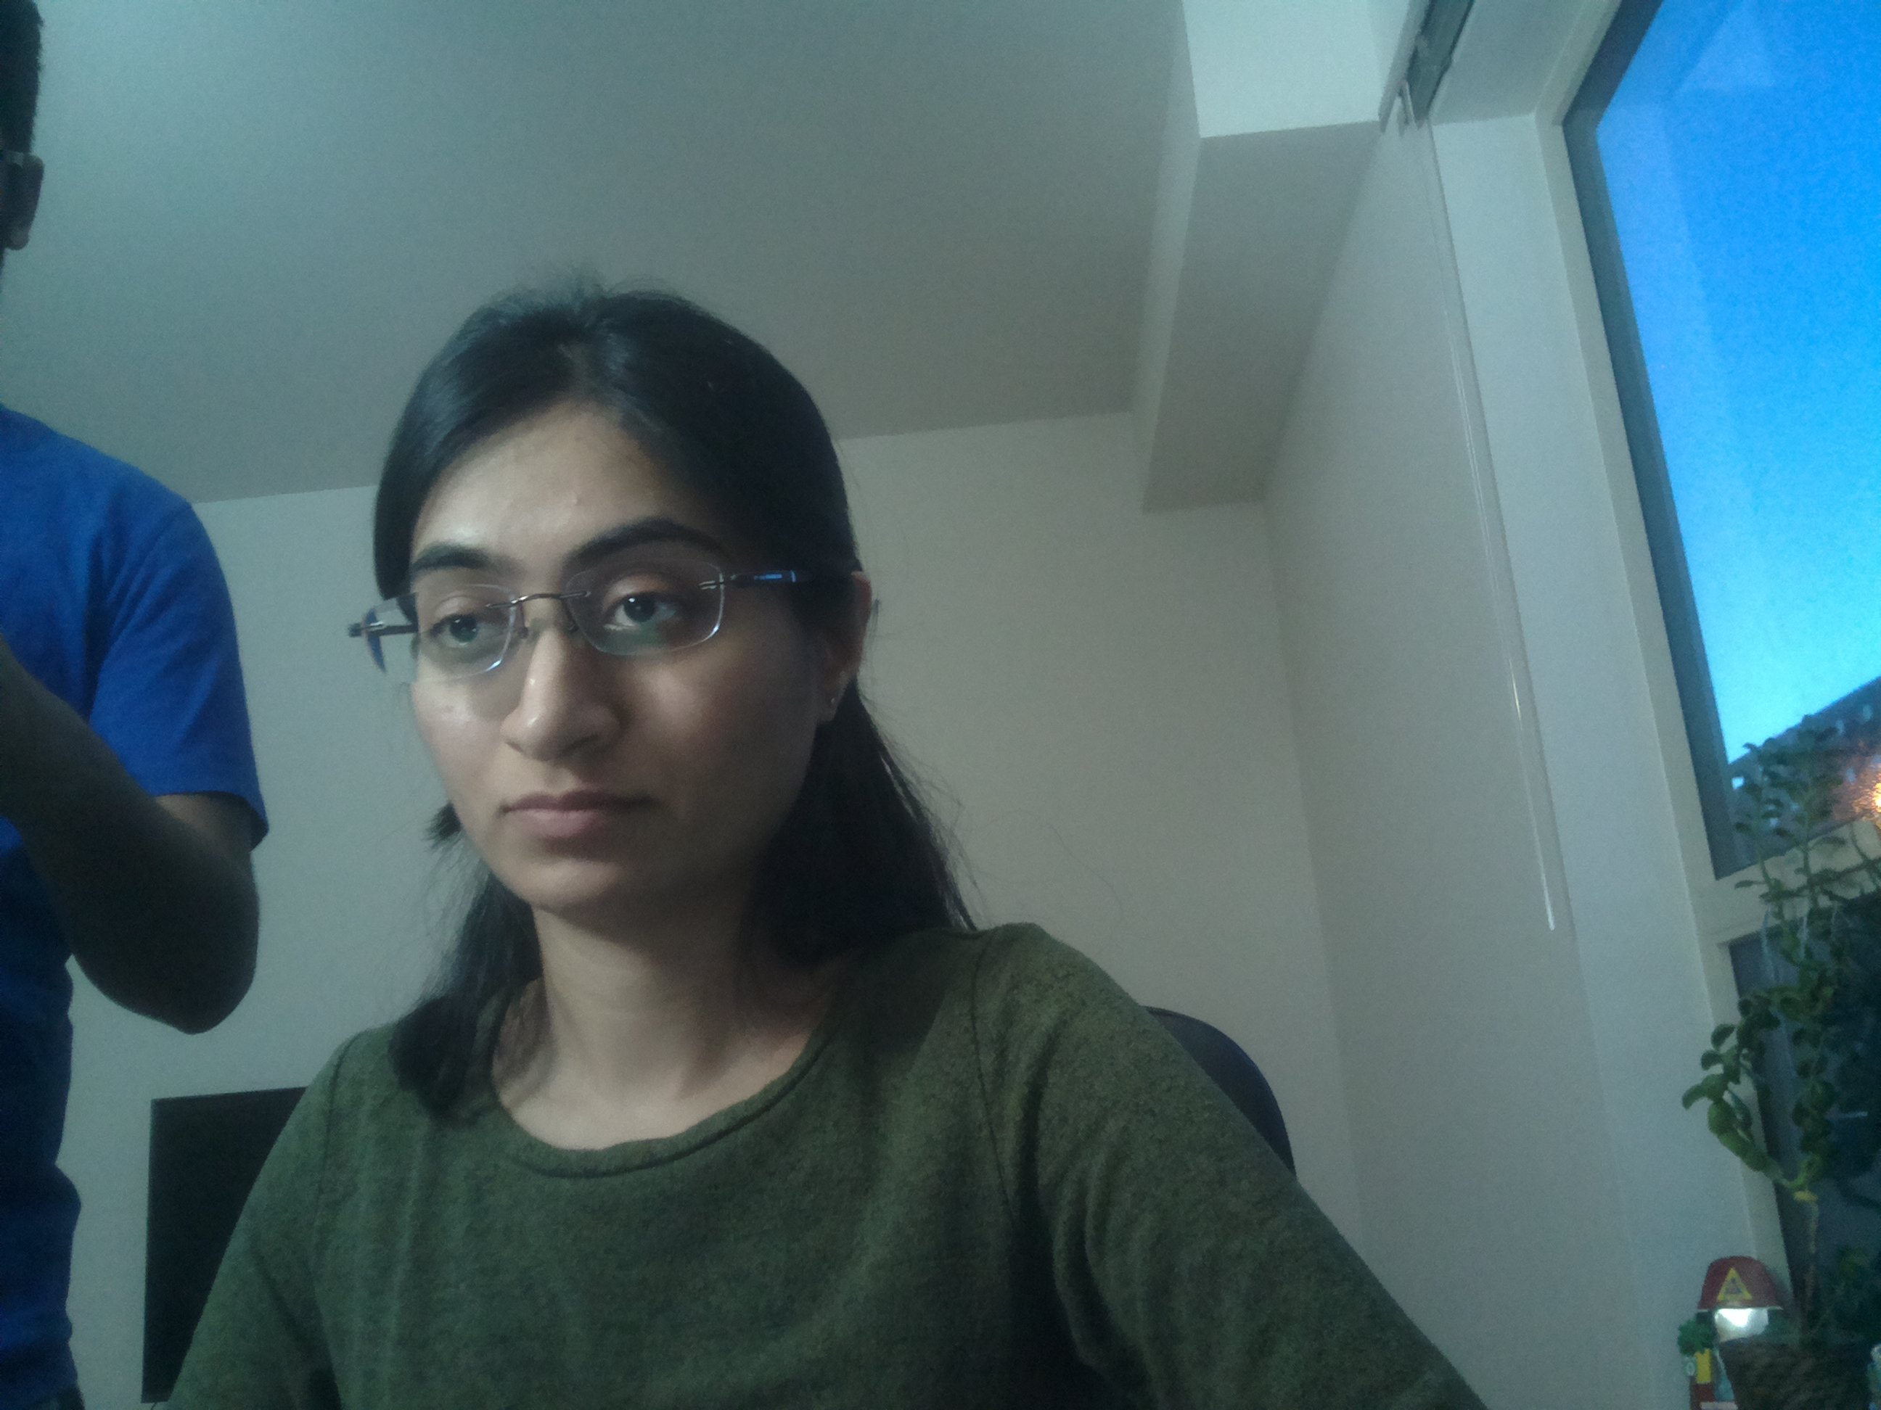
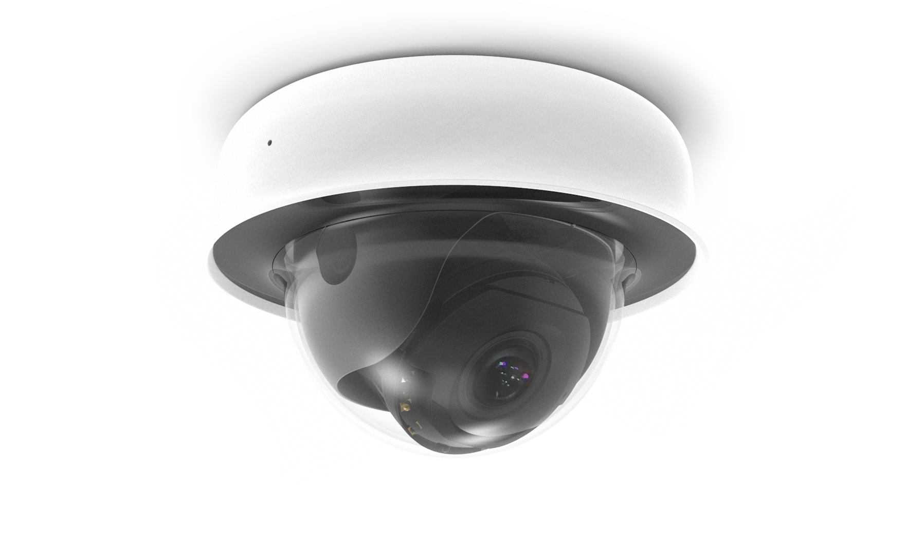
Picture Captured by Raspberry Pi

Slide 7
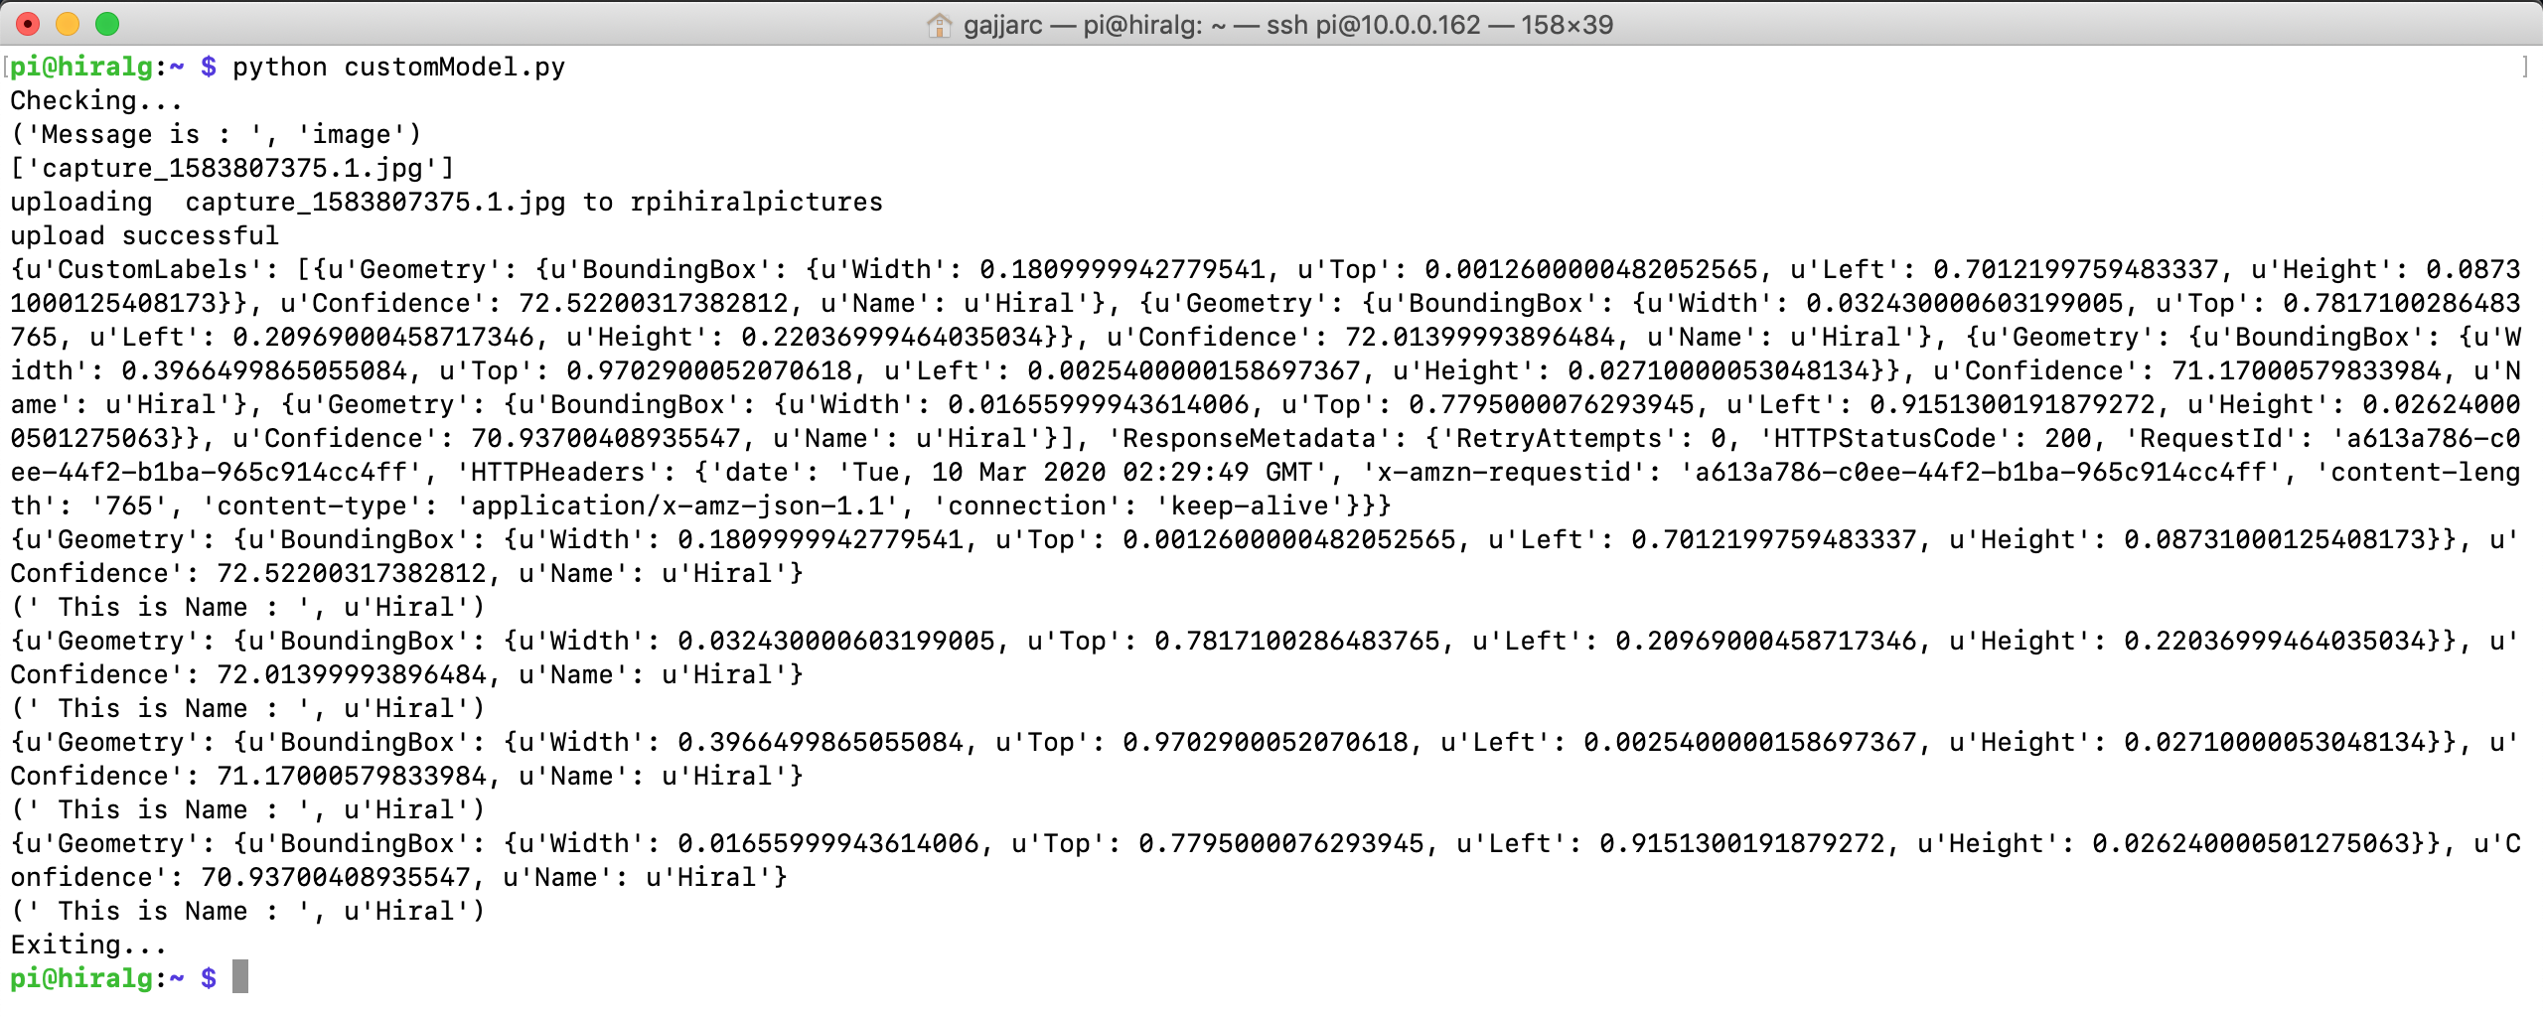
Screenshots – Raspberry Pi Terminal

Slide 8
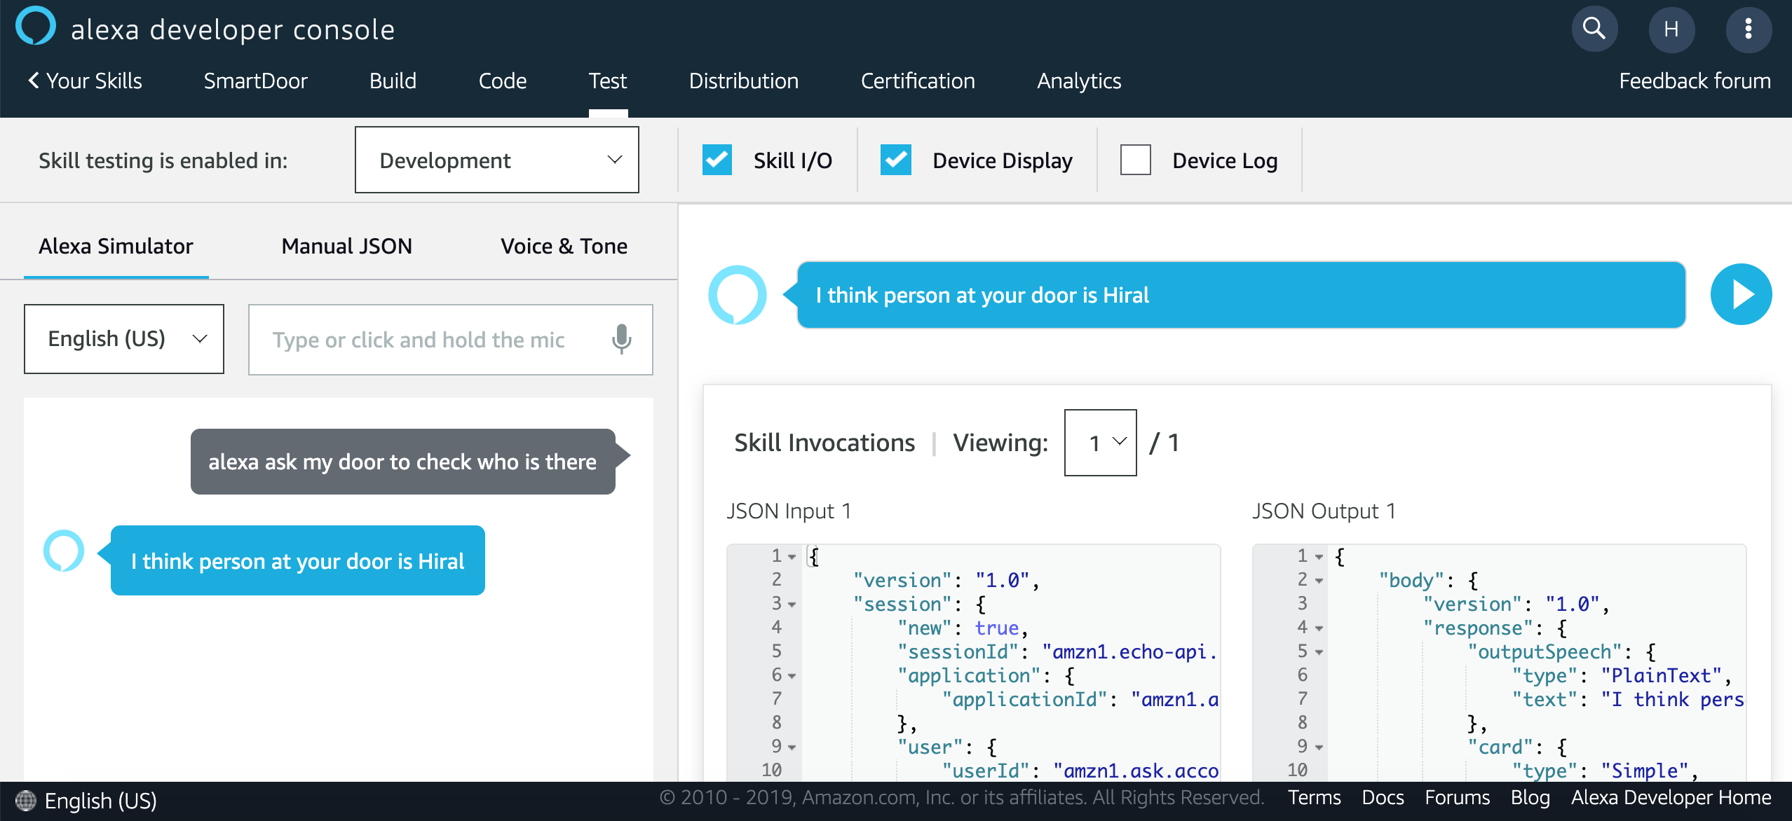
Screenshots – Alexa Skill Console

Slide 9
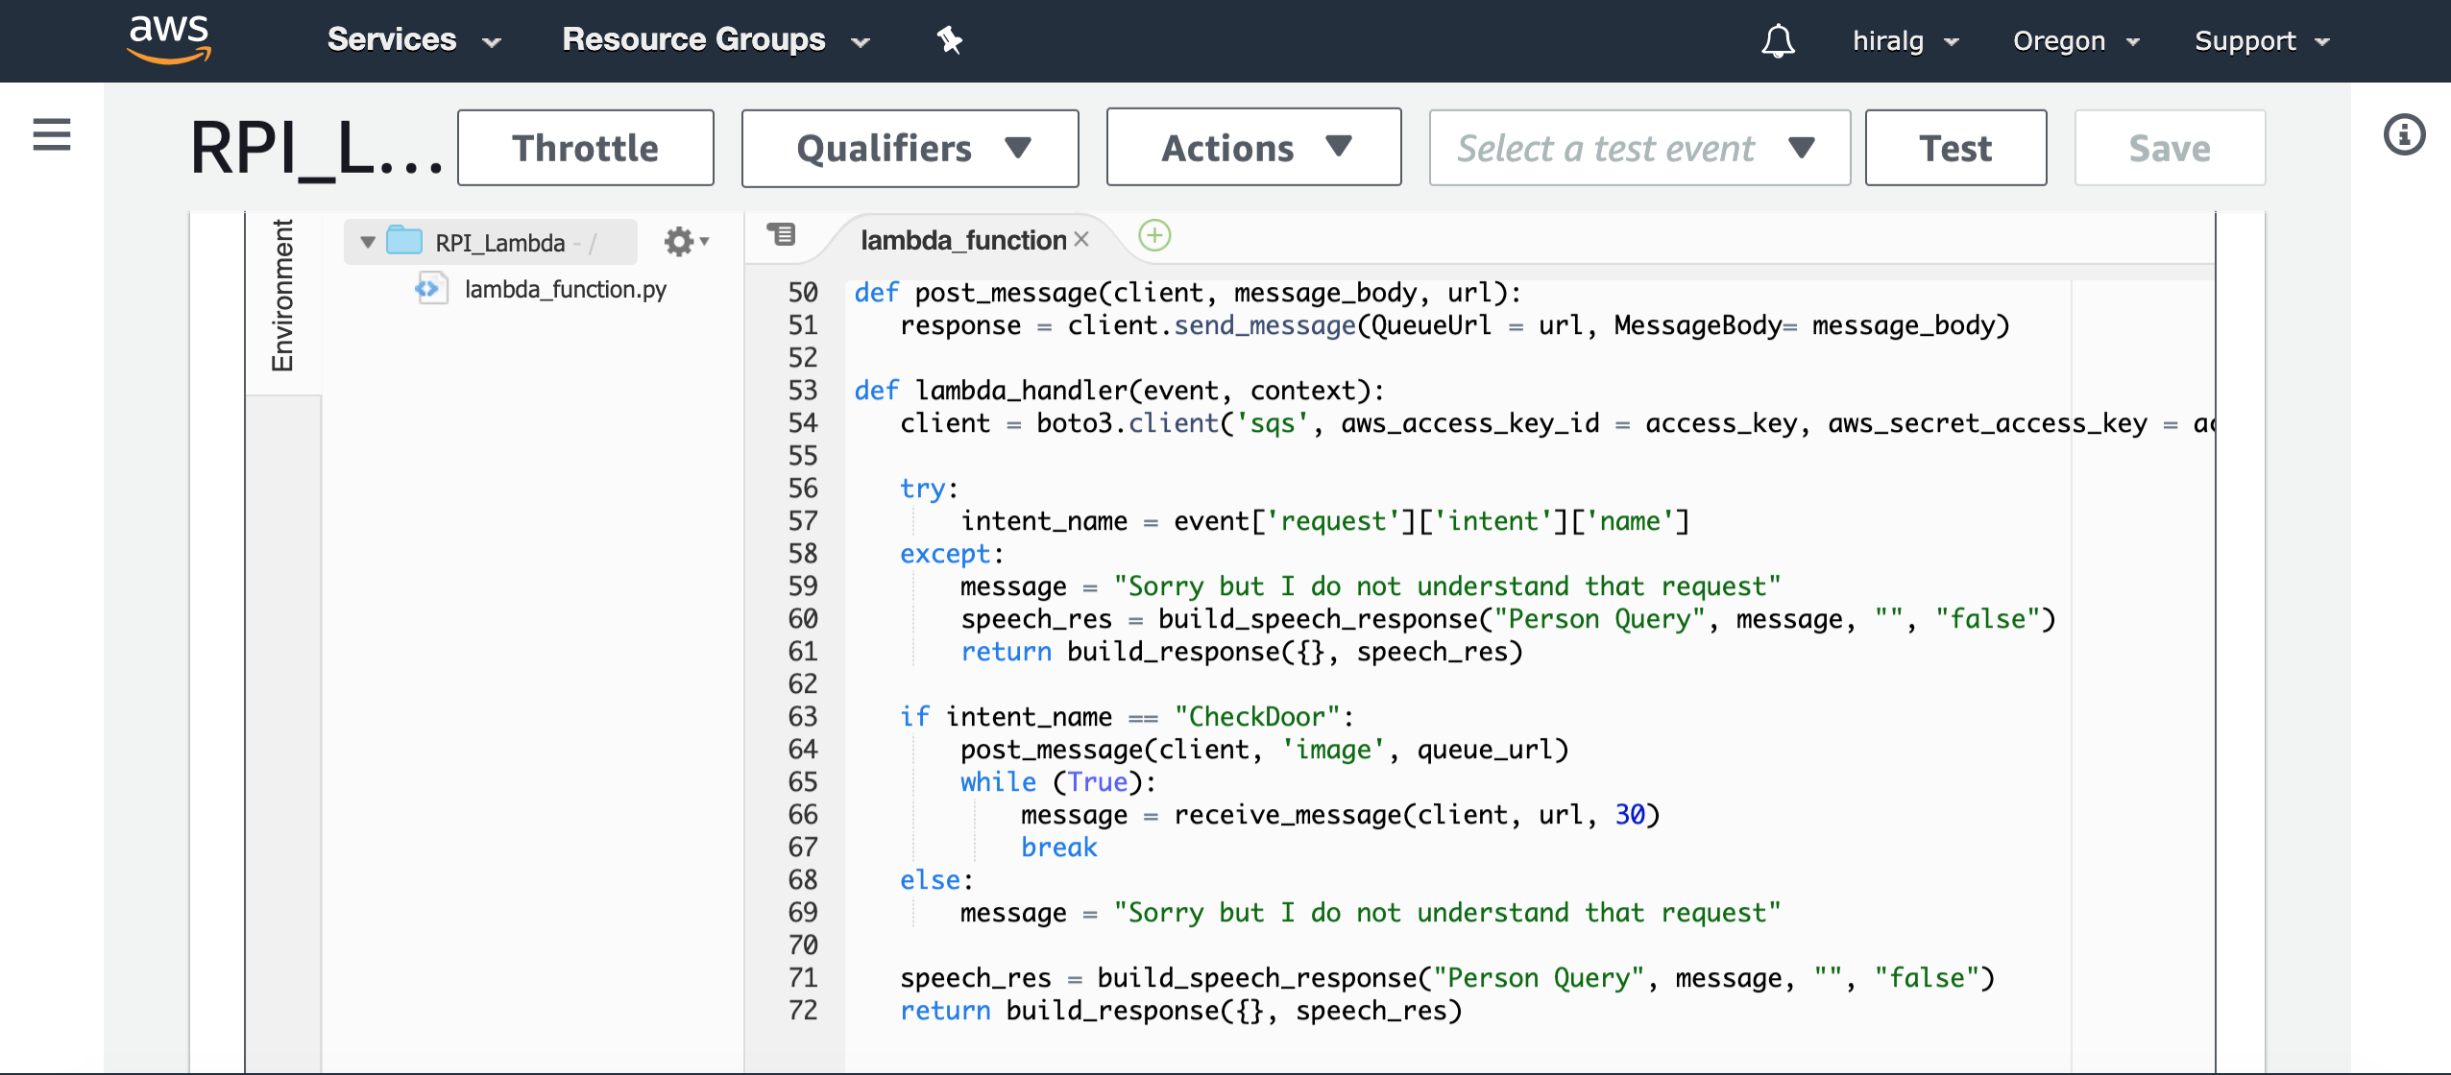
Screenshots – AWS Lambda Python code

Slide 10
Future Enhancements
Right now this app doesn’t tell you any detail about a person who is not recognized by model.
I want to add a feature that it can at least describe all the details like whether a person was male/female, he was wearing glasses or not etc.
I have created this project with Alexa AWS, but I haven’t taken care of security.
I will enhance the security of my data.
I want to attach motion sensor to raspberry pi so that it captures all the photo whenever any motion is detected.
Later I can ask Alexa to tell me who was at door at what time.

Slide 11
References
Alexa skill console : https://developer.amazon.com/en-US/alexa/alexa-skills-kit
Amazon AWS : aws.amazon.com
Drawing diagrams : https://www.draw.io/
Project Code : https://github.com/HiralMistry/Smart-DoorViewer

Slide 12

Thank You !!

